Slide 1

Receipt & Invoice Digitizer
Mentor: Dr.Santhiya Mam
Presented By: Pasula Nikhileshwar Reddy
Page
01

Slide 2
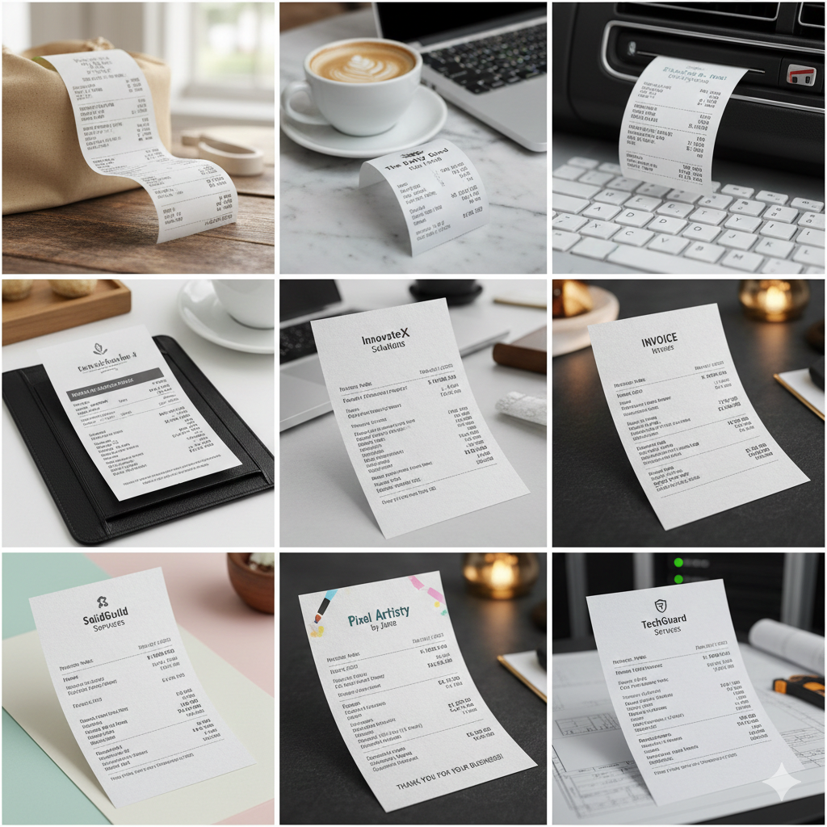

The Problem Statement
Manual text extraction from receipts/invoices is slow and error-prone.
So, we need a system to upload documents, preprocess images, and extract text using OCR for automated digitization.
Page
02

Slide 3
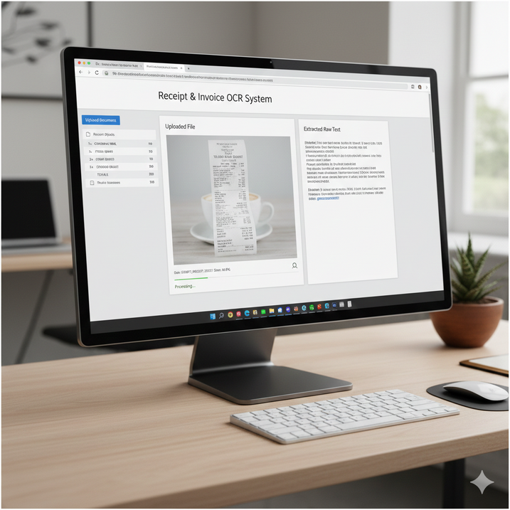

Objectives
Build file upload system (JPG/PNG/JPEG/PDF) with validation
Preprocess images (resize, grayscale, denoise, threshold)
Extract raw text using OCR (Tesseract/EasyOCR) and display output
Page
03

Slide 4
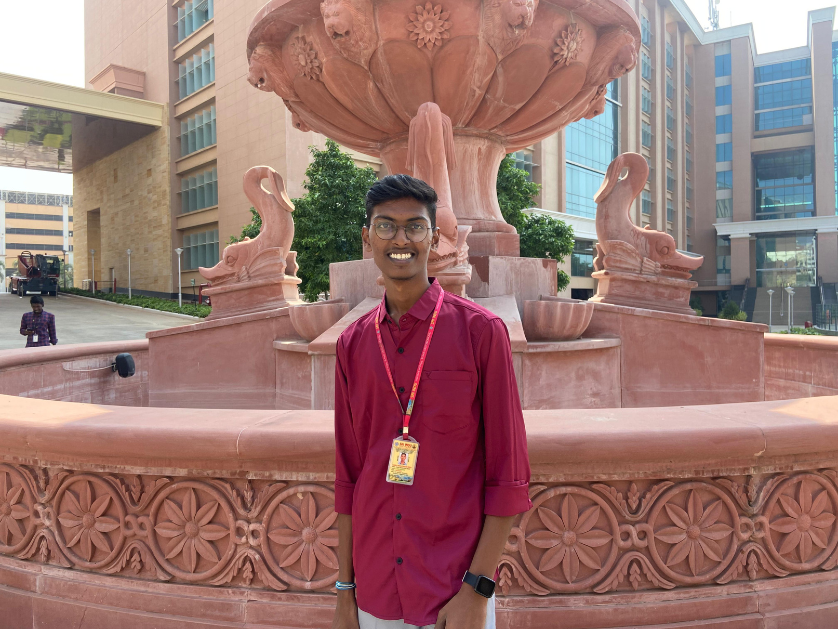
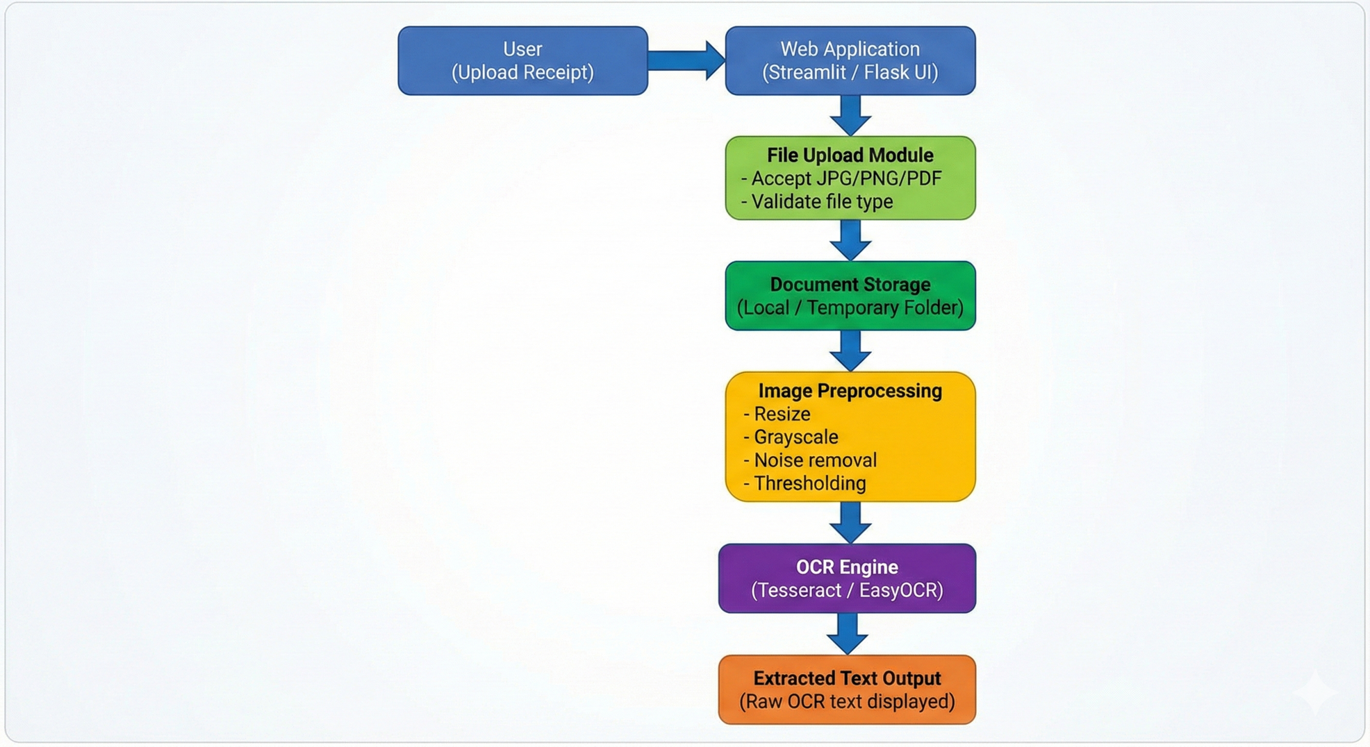
System Architechture
Page
04

Slide 5
System Architecture
User uploads receipt/invoice via web interface
File is validated & stored in backend temporarily
Image is preprocessed using OpenCV (resize, grayscale, denoise, threshold)
Preprocessed image sent to OCR engine (Tesseract/EasyOCR)
OCR generates raw text output
Extracted text is displayed to user for verification
Page
05

Slide 6
OCR Implementation Strategy
Use Tesseract OCR to extract raw text from receipts/invoices
Apply OpenCV preprocessing (grayscale, resize, denoise, threshold) before OCR
Handle different fonts/layouts using Tesseract PSM/OEM configurations
Extract text line-by-line for better accuracy across various receipt formats
Page
06

Slide 7
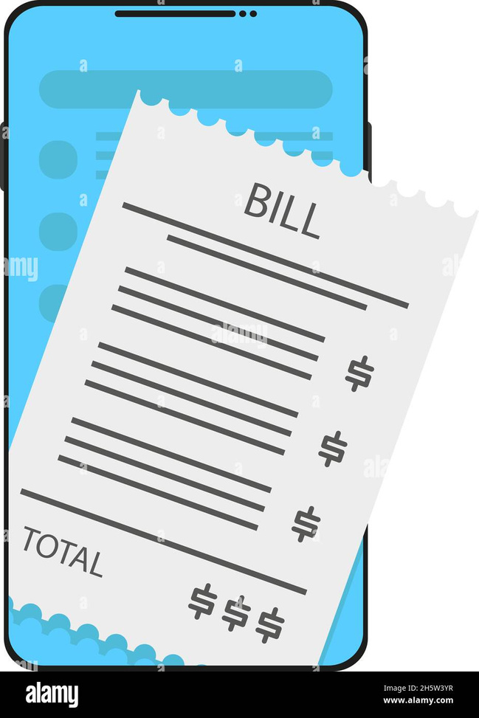
Evaluation & Validation
Compare OCR output with manual Ground Truth text file
Measure accuracy using text similarity metrics (word/character level)
Validate by testing multiple receipts with different layouts, fonts, and image quality
Page
07

Slide 8
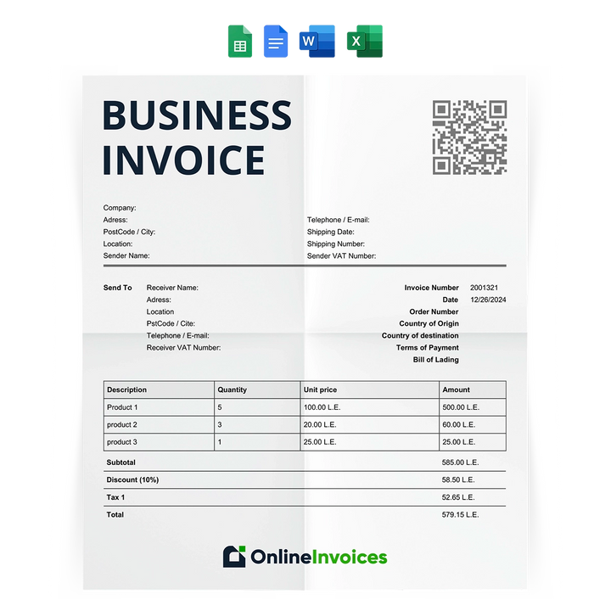
Conclusion
Milestone–1 completed OCR pipeline implementation
Includes file upload + preprocessing + raw text extraction
Creates base for future structured extraction & database storage
Page
08

Slide 9

Thank
You.
Page
09

